Slide 1
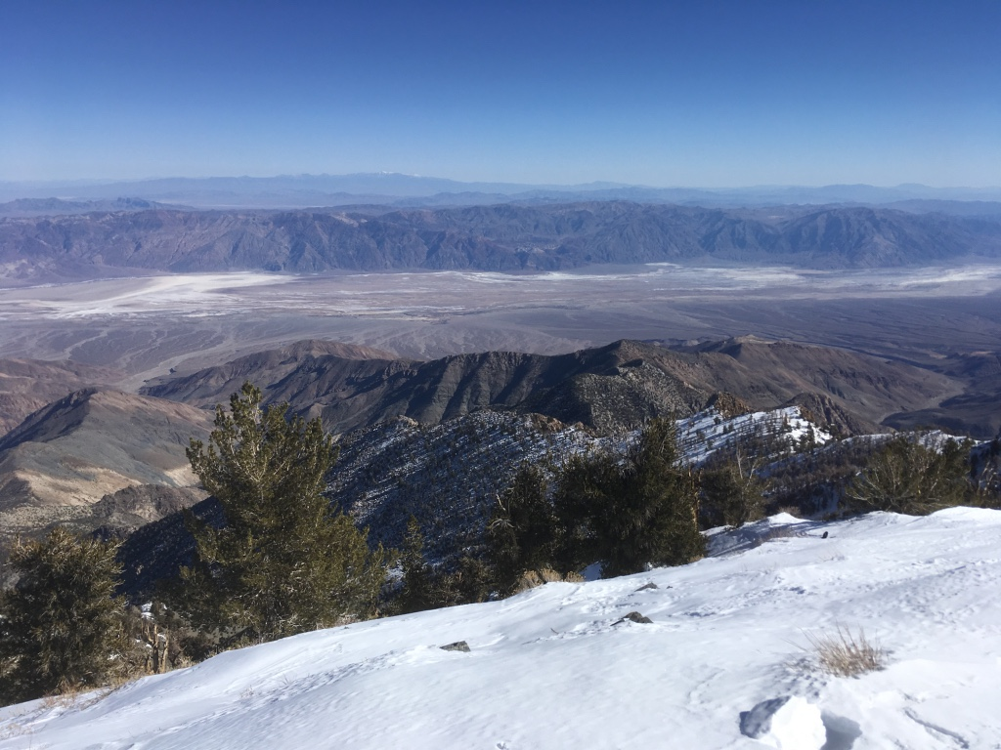
Extensional tectonics in the Death Valley area, California: Transport of the Panamint Range structural block 80 km northwestward
John H. Stewart, 1983
Presented by Luke J. Schranz

Slide 2
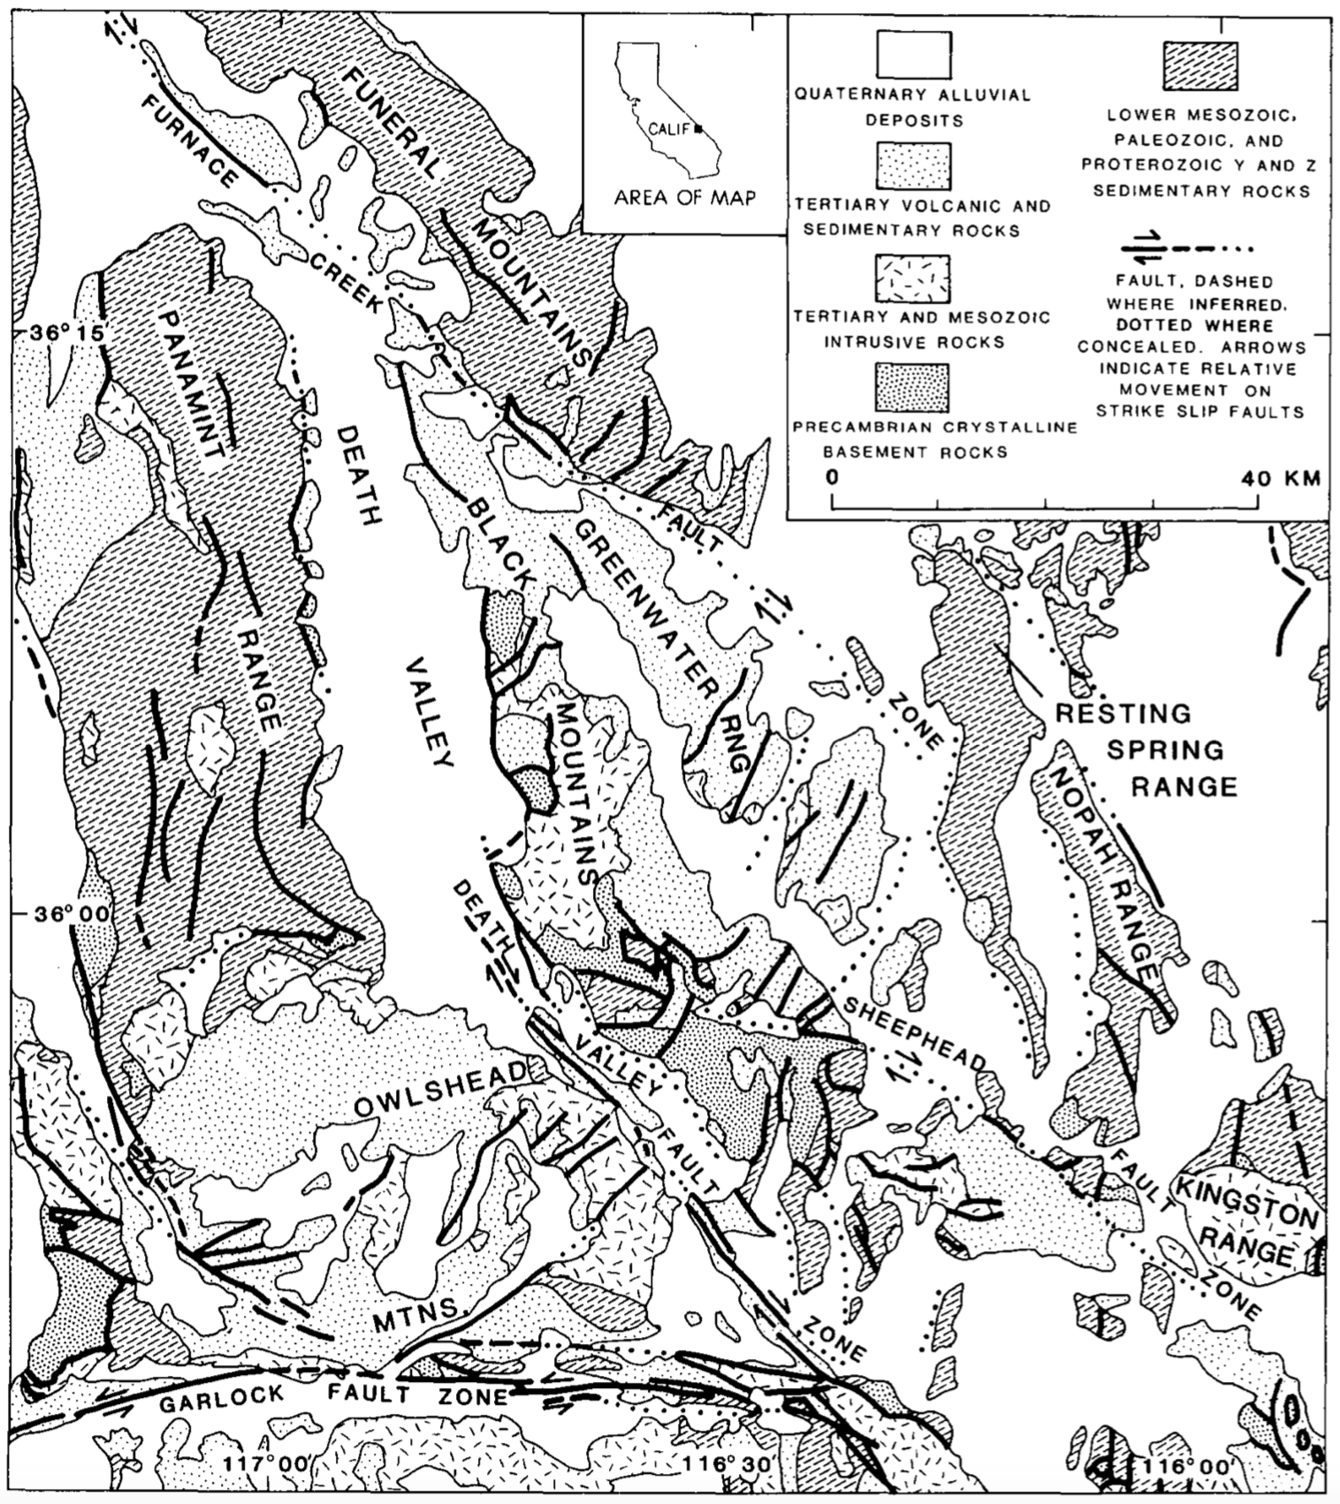

Slide 3
The Problem
Magnitude of strike-slip offset on fault zones in Death Valley area
Furnace Creek fault = 40-100km right-lateral offset
Death Valley fault = 8km right-lateral offset
70km
8km

Slide 4
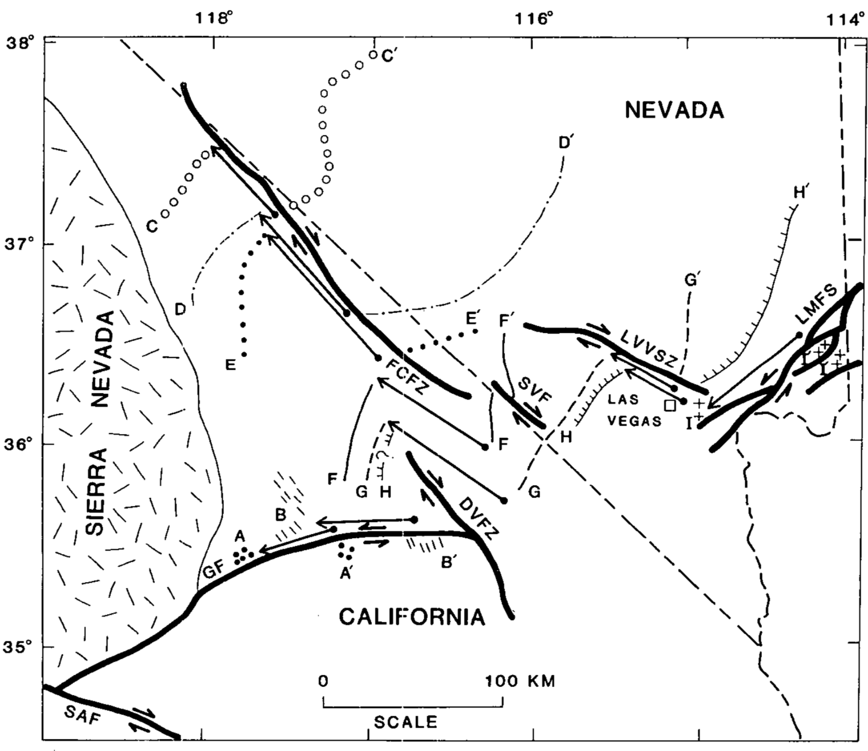

Slide 5
Hypothesis Presented
Precambrian through Mesozoic rocks in Panamint Range were transported along a low angle detachment fault structure (or system of faults)
80 km of of NW transport
Chaotic breccia and turtleback surfaces represent the detachment
Late Cenozoic timing because of 6-8ma volcanics and late normal faulting

Slide 6
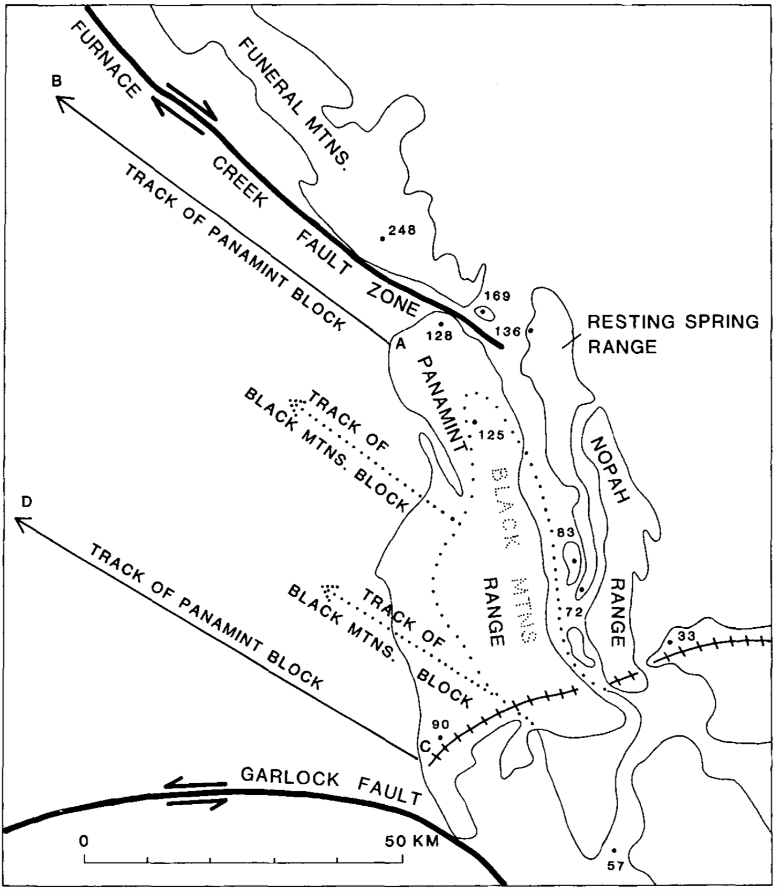

Slide 7
Evidence
10km of Precambrian and Paleozoic strata absent in Black Mountains
Unlikely an erosion phenomenon
Stratigraphic thickness trends and offsets are consistent with this reconstruction

Slide 8
Implications
Death Valley fault zone needs little right-lateral offset (could be entirely extensional)
Explains why 200km Furnace Creek fault zone abruptly ends in this area
Panamint block and Black Mountains block moved on separate, shallow west-dipping detachments (BMb = structurally lower)
Works with early interpretations of the area (Noble 1941)

Slide 9
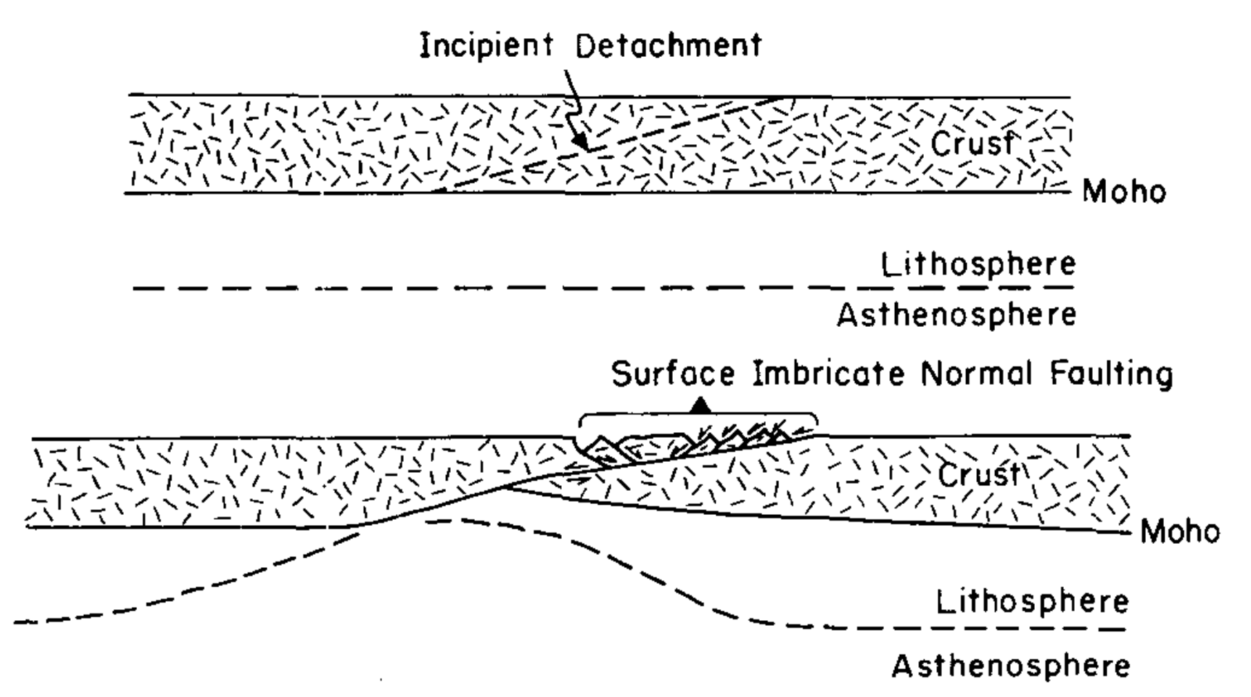

Slide 10
Regional Implications
Garlock fault is major south bounding structure for blocks
Late right lateral movement along Death Valley fault may exist and Death Valley could be resultant pull apart basin

Slide 12
Lateral extension?

Slide 13
Questions
Did Garlock and/or Furnace Creek faults exist before detachment structure?
How far west to the west does the detachment exist (rocks west of the Panamint block)?
Is there geologic evidence for extension along the Death Valley fault structure?

